Slide 1
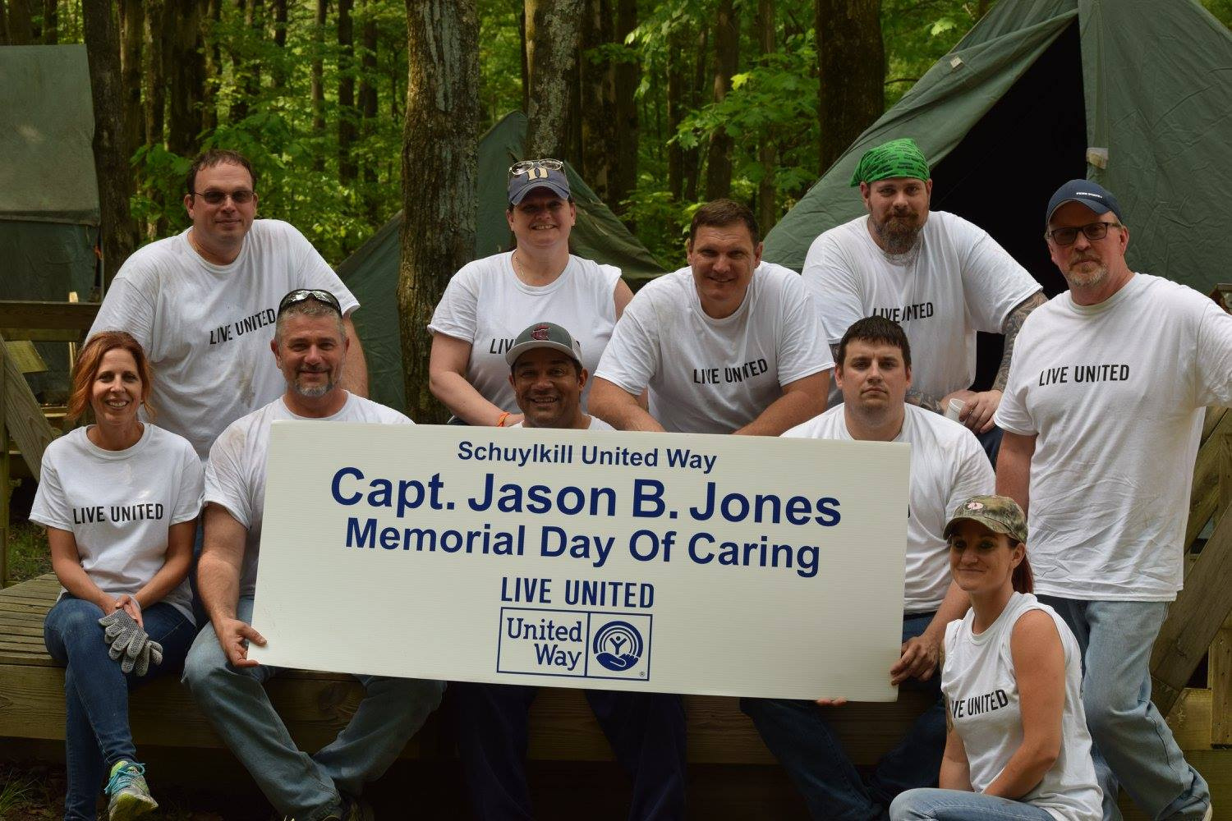


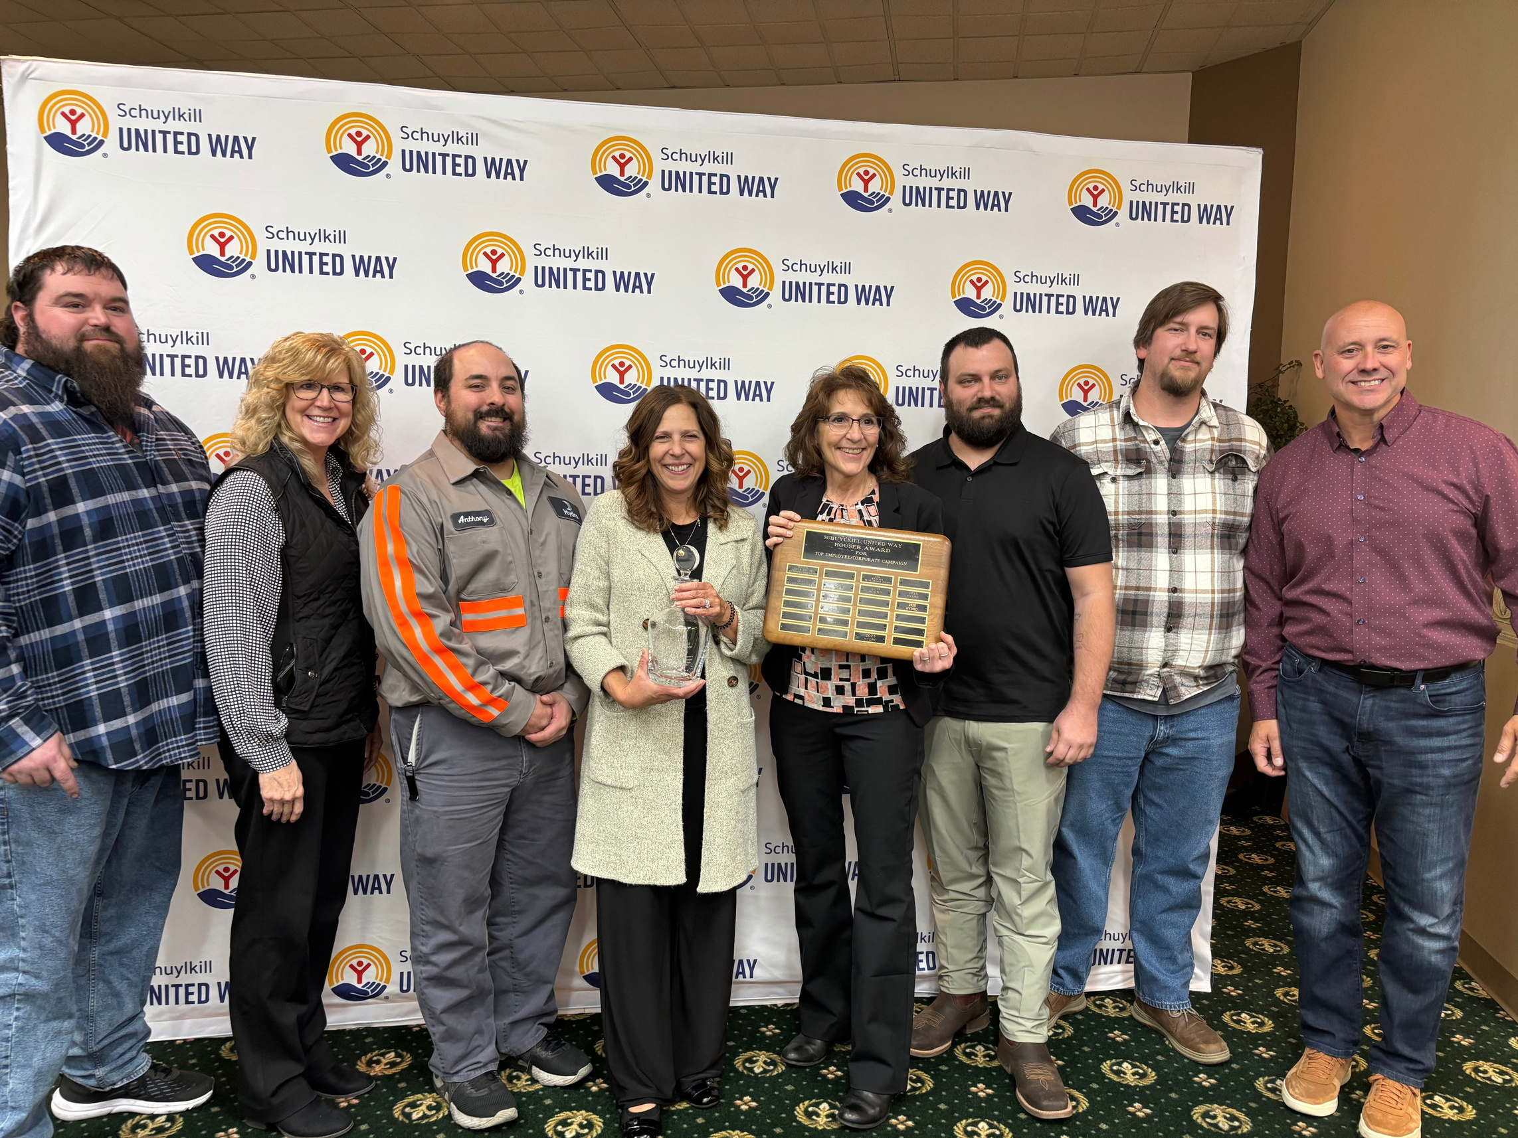

Slide 2


Slide 3

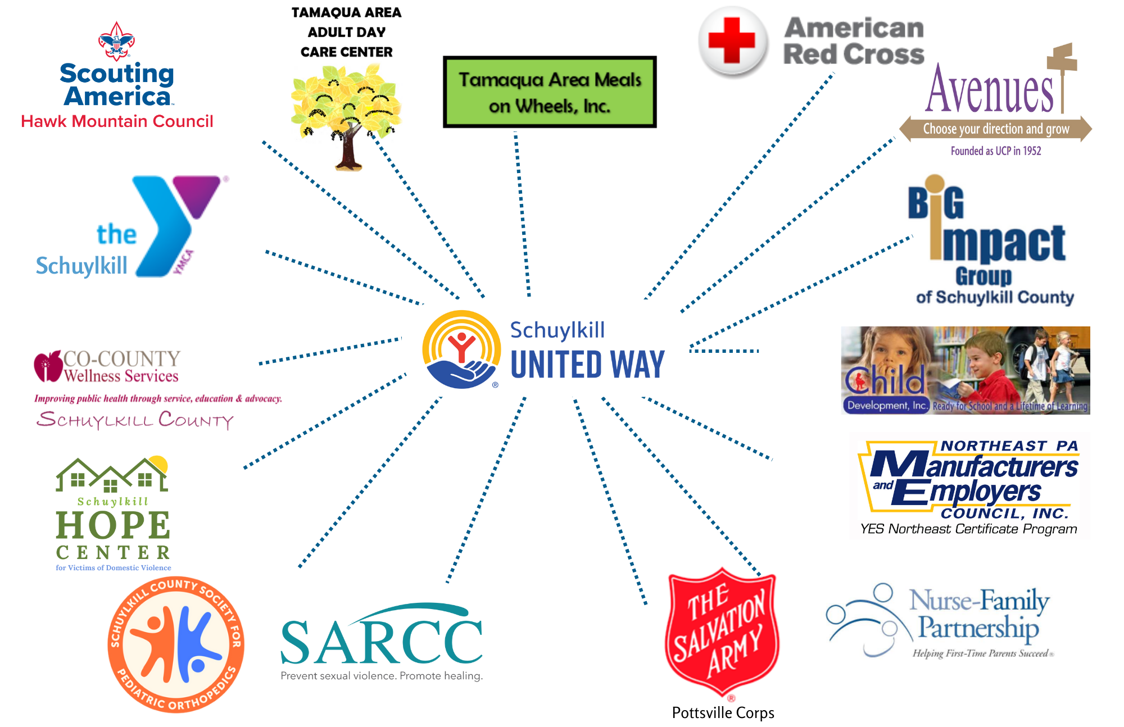

Partner
Agencies

Slide 4
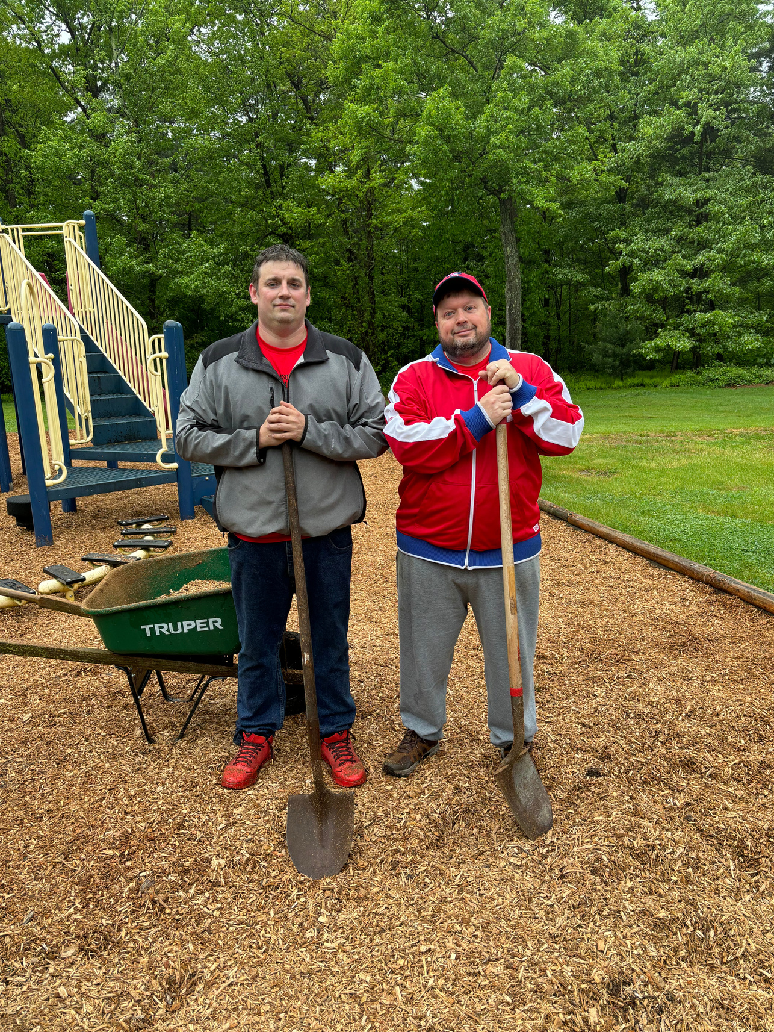


SUW CAMPAIGN FACTS
Goal: $1,190,000
65% of donations come
from individuals
98.5% of the money raised
stays in Schuylkill County

Slide 5
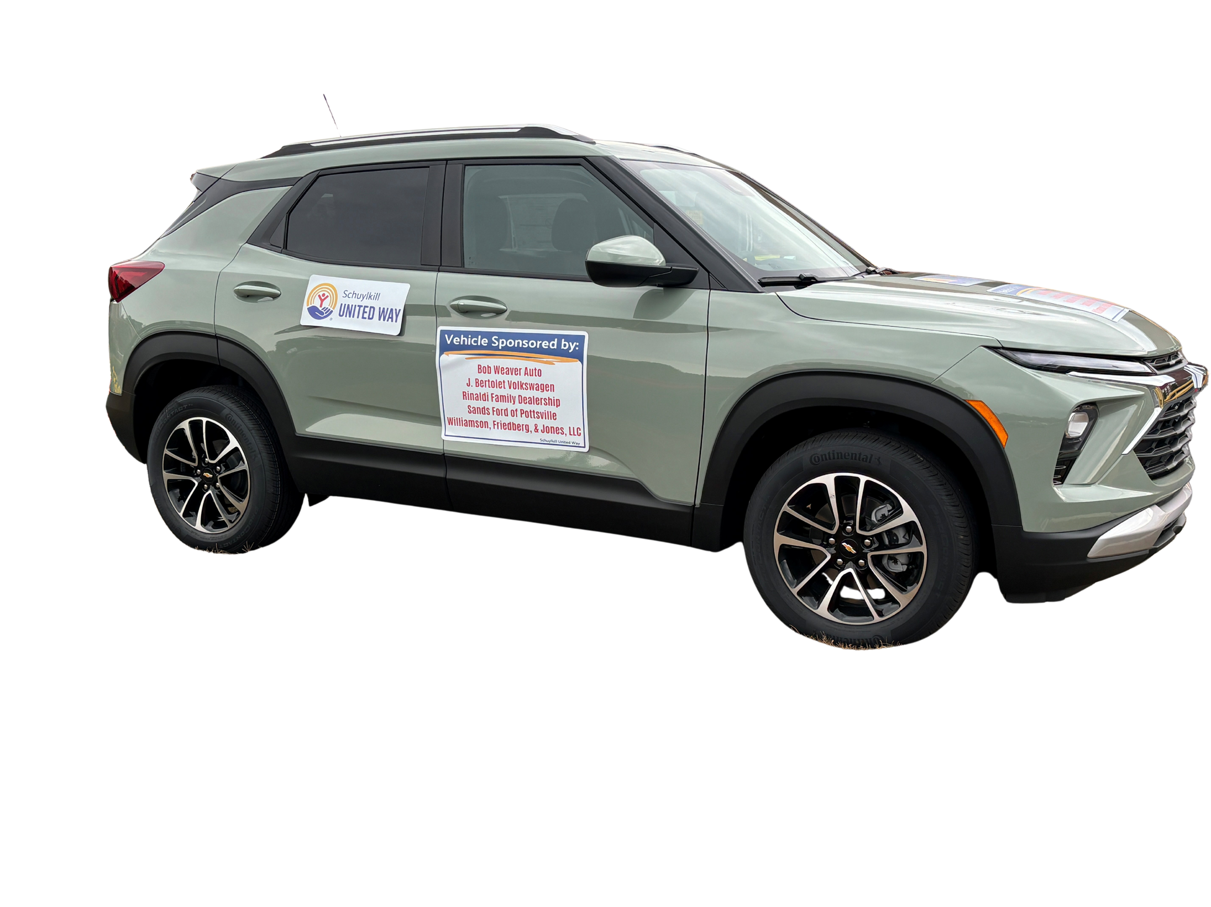



ALL SUW CAMPAIGN PRIZES
ARE DONATED BY LOCAL BUSINESSES!
$28,000
Value!
Rinaldi Family Dealership | Bob Weaver Auto | J. Bertolet Volkswagen | Sands Ford of Pottsville | WFJ Law

Slide 6
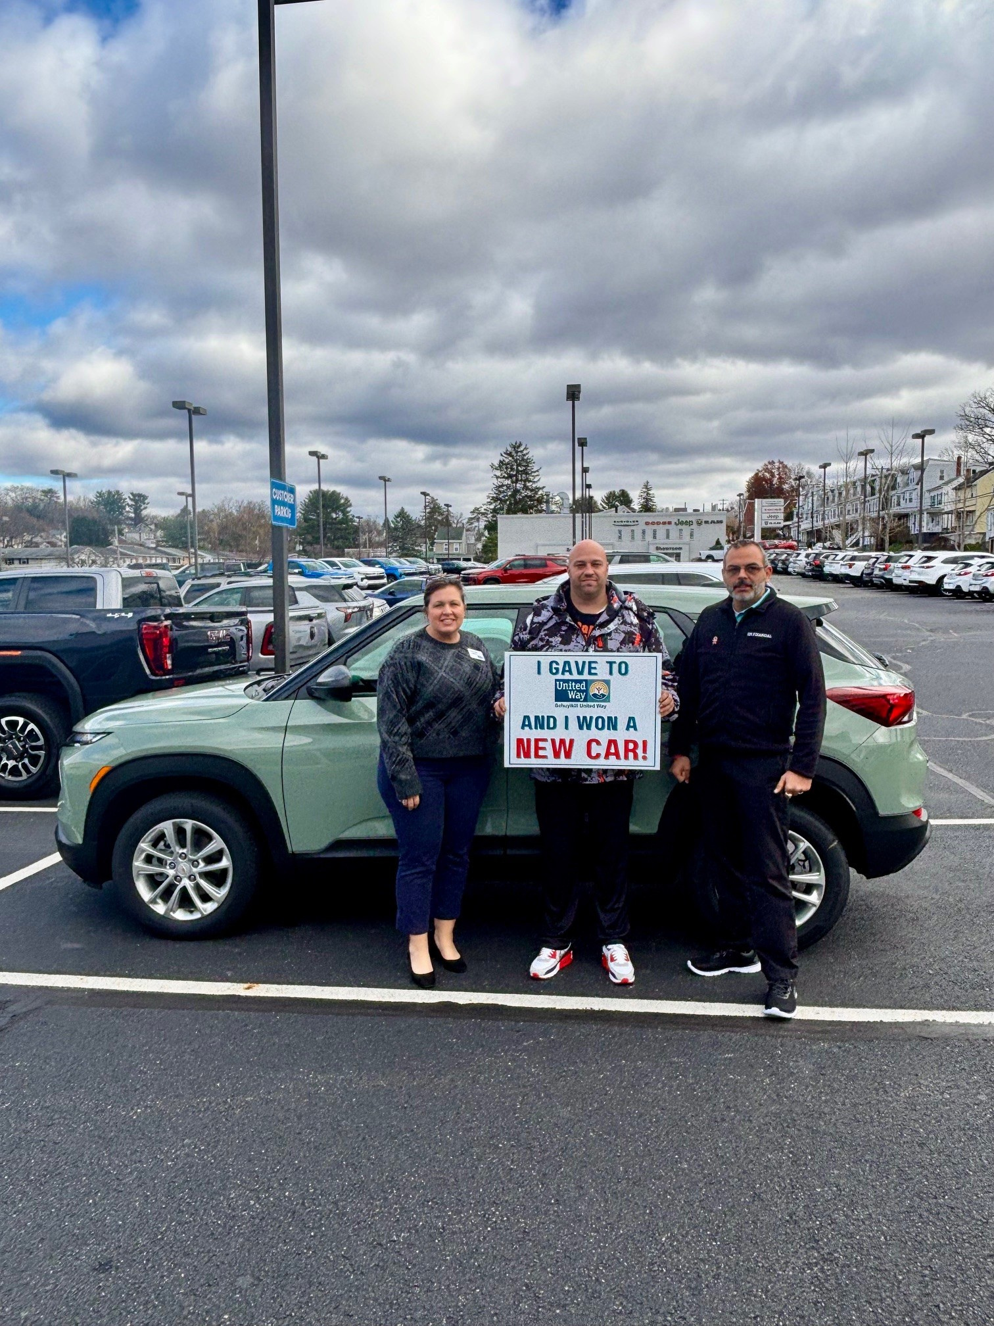

Slide 7
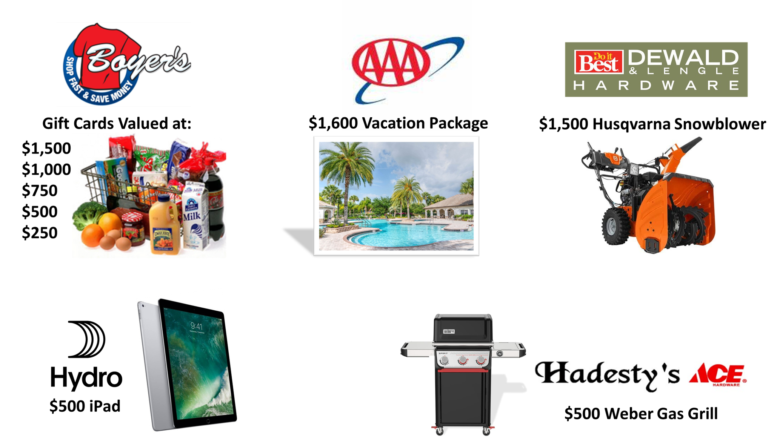
ALL SUW CAMPAIGN PRIZES
ARE DONATED BY LOCAL BUSINESSES!

Slide 8


